Slide 1


CSE260
Digital Logic Design

Slide 2


SOP & POS
Sum-of-Products (SOP) Expression: a product term or a logical sum
(OR) of several product terms.
Examples: x+yz', xy'+x'yz, AB+A'B’
Product-of-Sums (POS) Expression: a sum term or a logical product (AND) of several sum terms.
Examples: x(y+z'), (x+y')(x'+y+z), (A+B)(A'+B’)
Every boolean expression can either be expressed as sum-of-products or product-of-sums expression.
Examples:

Slide 3
MIN & MAX TERM

Slide 4
MIN & MAX TERM
Minterms are sum terms.
For Boolean functions, the minterms of a function are the terms for which the result is 1.
Boolean functions can be expressed as sum- of-Minterms.
Maxterms are Product terms.
For Boolean functions, the maxterms of a function are the terms for which the result is 0.
Boolean functions can be expressed as Products-of-Maxterms.

Slide 5
MIN and MAX
 | A | B | C | F
0 | 0 | 0 | 0 | 1
1 | 0 | 0 | 1 | 1
2 | 0 | 1 | 0 | 0
3 | 0 | 1 | 1 | 0
4 | 1 | 0 | 0 | 1
5 | 1 | 0 | 1 | 1
6 | 1 | 1 | 0 | 0
7 | 1 | 1 | 1 | 0
Min Terms : 0,1,4,5 [000,001,100,101] F=∑(0,1,4,5)
Max Terms : 2,3,6,7 [010,011,110,111] F=Π(2,3,6,7)

Slide 6

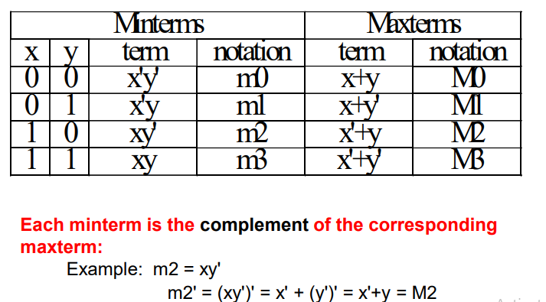
Here, x and y are random variables used for understanding purpose
and do not represent any specific function

Slide 7
Conversion between MIN & MAX
x | y | z | F2 | F2'
0 | 0 | 0 | 0 | 1
0 | 0 | 1 | 1 | 0
0 | 1 | 0 | 0 | 1
0 | 1 | 1 | 0 | 1
1 | 0 | 0 | 1 | 0
1 | 0 | 1 | 1 | 0
1 | 1 | 0 | 1 | 0
1 | 1 | 1 | 1 | 0
F2 = Σ(m1,m4,m5,m6,m7)
The complement function of F2 is:
F2' = Σ(m0,m2,m3) = m0 + m2 + m3
F2 = (m0 + m2 + m3 )'
= m0' . m2' . m3'
= M0 . M2 . M3
= Π(M0,M2,M3)
Every Boolean function can be expressed as either Sum-of-Minterms or Product-of-Maxterms.

Slide 8
MIN-SOP and MAX-POS
 | A | B | C | F
0 | 0 | 0 | 0 | 1
1 | 0 | 0 | 1 | 1
2 | 0 | 1 | 0 | 0
3 | 0 | 1 | 1 | 0
4 | 1 | 0 | 0 | 1
5 | 1 | 0 | 1 | 1
6 | 1 | 1 | 0 | 0
7 | 1 | 1 | 1 | 0
Min Terms : 0,1,4,5 [000,001,100,101] F=∑(0,1,4,5)
F=A’B’C’+A’B’C+AB’C’+AB’C
Max Terms : 2,3,6,7 [010,011,110,111] F=Π(2,3,6,7)
F=(A+B’+C)(A+B’+C’)(A’+B’+C) (A’+B’+C’)
Min/SOP
0-Prime, 1-No prime
AND among literals
OR among terms
Max/POS
1-Prime, 0-No prime
OR among literals
AND among terms

Slide 9
Simplified Function to SOP & POS

Slide 10
How to Covert into SOP:
Check if each term contains all variable, if not then AND (x+x’) if x is the missing term
Simplified Function, F=A+B’C

Slide 11
How To Convert into SOP
F=A+B’C
=A(B+B’)(C+C’)+B’C(A+A’)
=(AB+AB’)(C+C’)+B’C(A+A’)
=AB(C+C’)+AB’(C+C’)+B’C(A+A’)
=ABC+ABC’+AB’C+AB’C’+AB’C+A’B’C
=ABC+ABC’+AB’C+AB’C’+A’B’C
=∑(1,4,5,6,7)

Slide 12
How to Covert into POS:
Often distributive law (x+yz)=(x+y)(x+z)) is used
If then terms, like x, are missing, OR xx’
Each POS is missing a term so OR missing terms, Again apply distributive law
Simplified Function, F=A+B’C

Slide 13
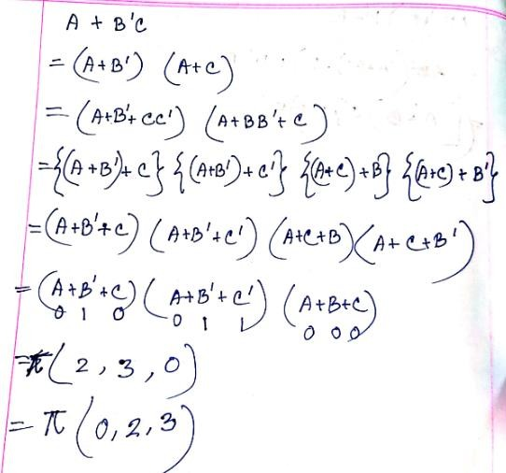
How to Convert into POS

Slide 14

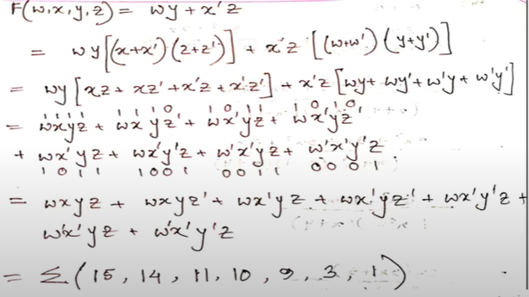
Another Example
Find SOP and POS for F(w,x,y,z) =wy+x’z
SOP

Slide 15
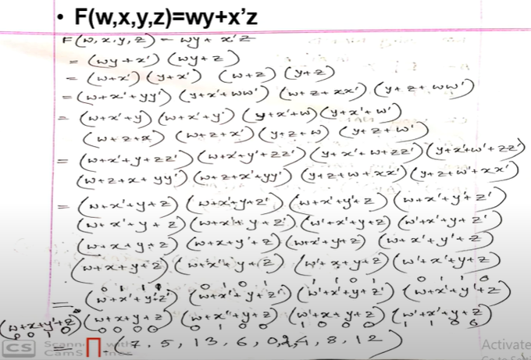
Another Example
Find SOP and POS for F(w,x,y,z) =wy+x’z
POS

